Slide 1
Blood Bank

Slide 2
Table Of Contents
1 Introduction
2 ER-Diagram
3 Technologies Used
4 Facilities Required
5 Project Snapshot
6 Conclusion

Slide 3
Introduction
This project is aimed to developing an online Blood Donation Information. The entire project has been developed keeping in view of the distributed client server computing technology, in mind.
The Blood Donation Agent is to create an e-Information about the donor and organization that are related to donating the blood. Through this application any person who is interested in donating the blood can register himself in the same way if any organization wants to register itself with this site that can also register. Moreover if any general consumer wants to make request blood online he can also take the help of this site.

Slide 4

ER-Diagram
Admin
DataBase
Call Center
Donor
Blood Donation Agent
Organization
Future Use

Slide 5
DFD Diagram
Call Center
Login
updating and
editing
Value Abilities Table

Slide 6
Technology Used
FRONT END TOOL JS Java Script HTML- Hyper Text Markup Language CSS- Cascading Style Sheet

Slide 7
FACILITES REQUIRED
Hardware
Software
Processor: Intel Pentium IV or Equivalent running @ 1.6 GHz or more. RAM: 256 MB SYSTEM BUS: 32 or 64 bits RAM: 256 MB of RAM HDD: 40 GB or higher
OS :MS WINDOWS 8 ,7
Front end: HTML, CSS, JavaScript

Slide 8
Project Snapshots

Slide 9
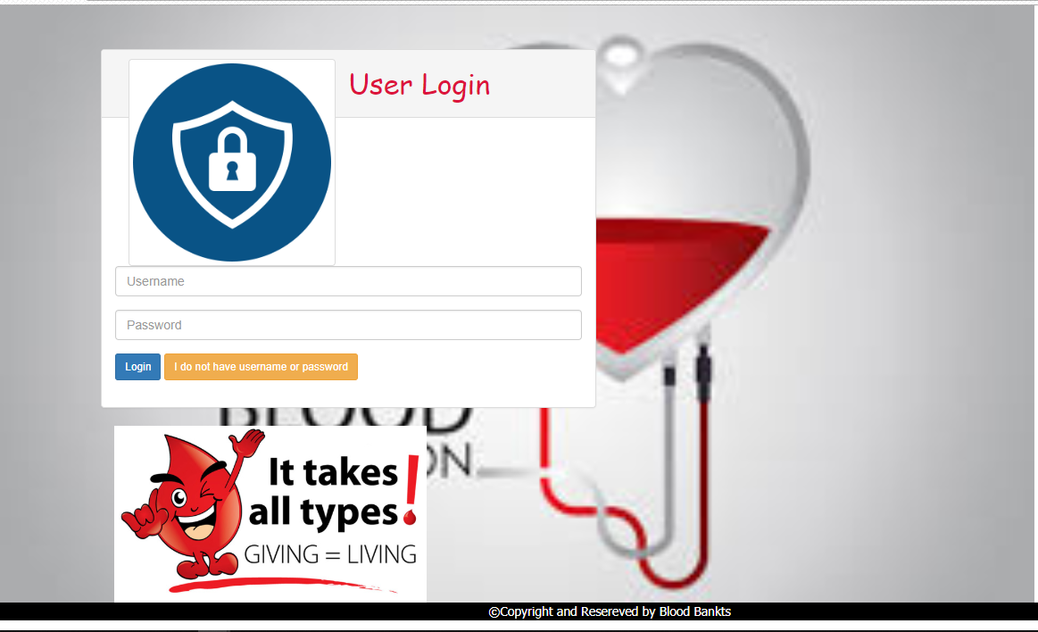
Login

Slide 10
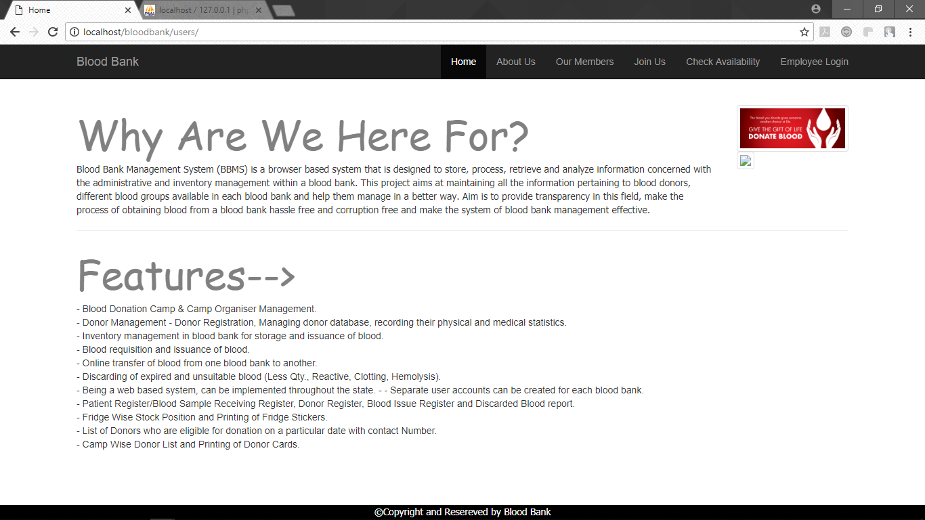
home

Slide 11
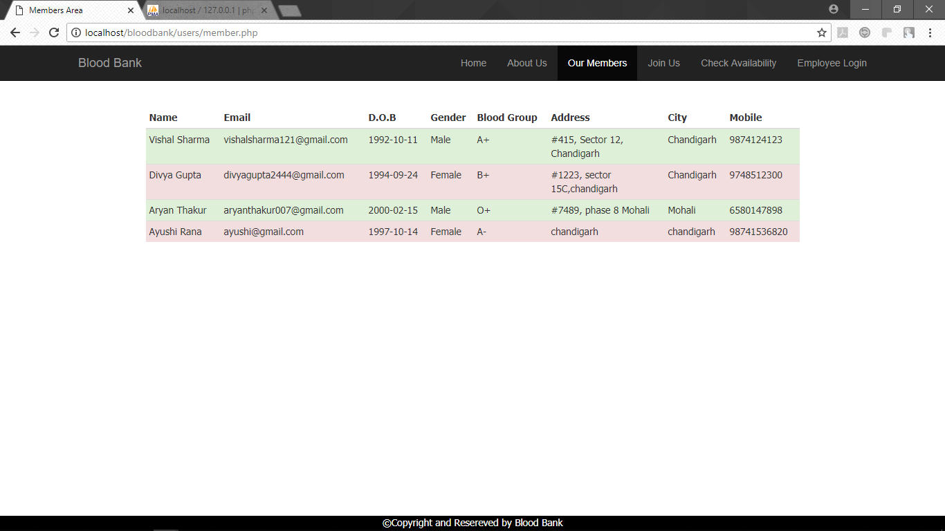
Members List

Slide 12
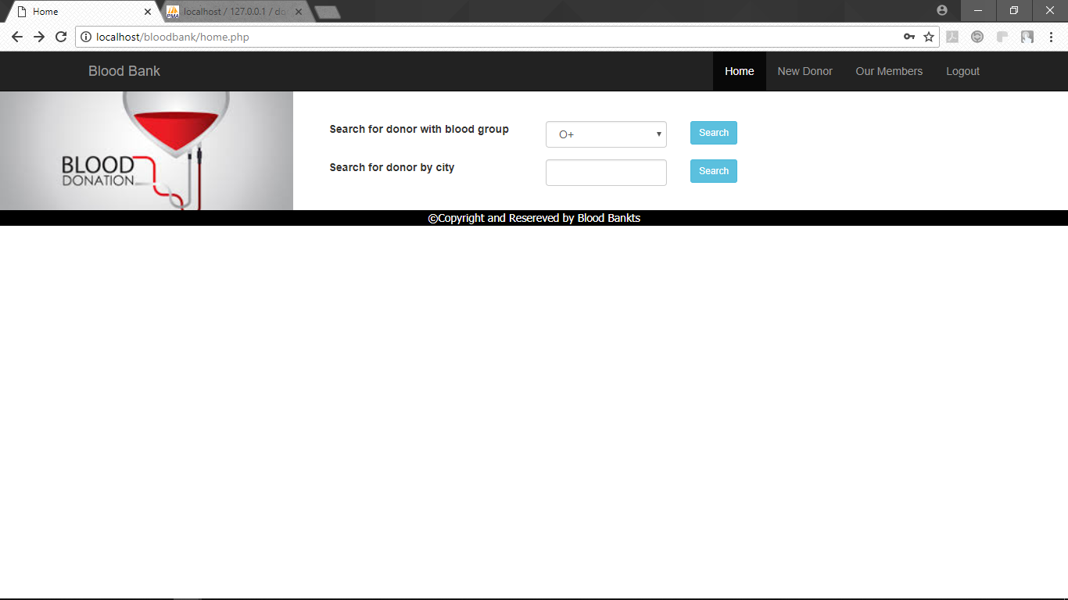
Search donor

Slide 13
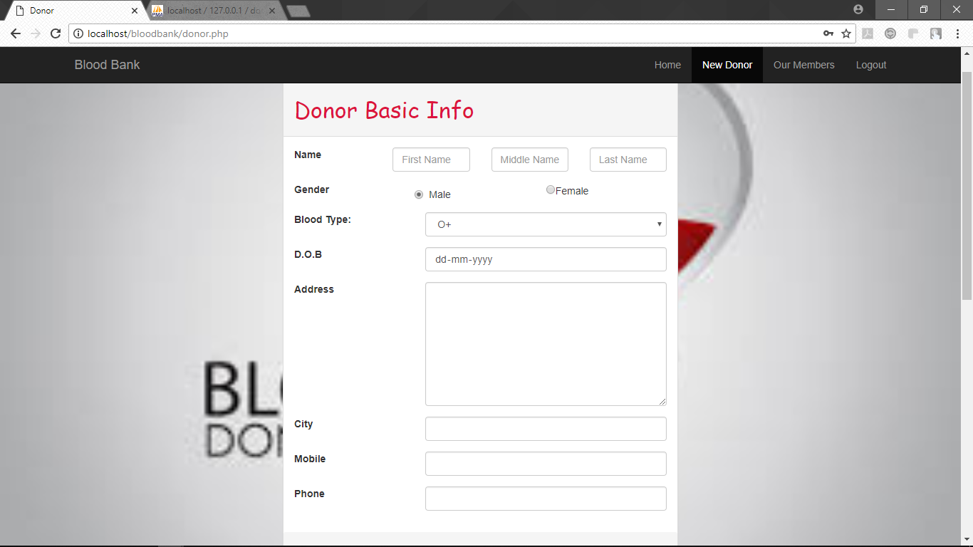
New Donor Form

Slide 14
CONCLUSION

Slide 15
CONCLUSION
In our project, users can online registered themselves and can access to contents of our site.
The main aim of this project was to put whatever was learnt in HTML into practice.
One most important feature of our project is that it is completely secured, every can access without userid and password. Control of the site is with user.

Slide 16
Thank You

